Slide 1




22.04 Release
@RAPIDSai
https://github.com/rapidsai
https://rapids-goai.slack.com/join
https://rapids.ai
Notes:
https://rapids.ai/ https://github.com/rapidsai
https://docs.rapids.ai/overview

Slide 2
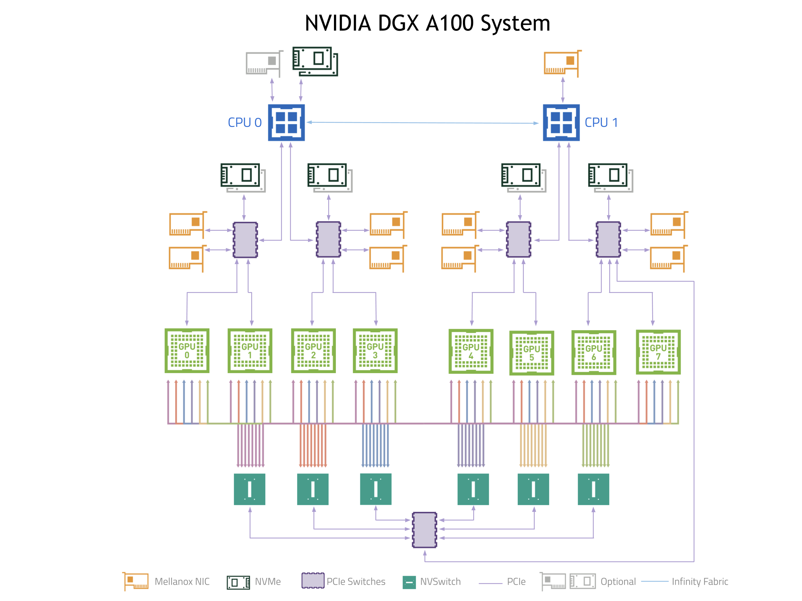
Why GPUs for Data Science?
Numerous hardware advantages
Thousands of cores with up to ~20 TeraFlops of general purpose compute performance
Up to 1.5 TB/s of memory bandwidth
Hardware interconnects for up to 600 GB/s bidirectional GPU <--> GPU bandwidth
Can scale up to 16x GPUs in a single node
Almost never run out of compute relative to memory bandwidth!

Slide 3
What is RAPIDS?
End-to-End GPU Accelerated Data Science
Data Preparation/ETL
Analytics/ML/Graph
Visualization
cuDF
GPU-accelerated ETL functions
Tracks Pandas and other common PyData APIs
Dask + UCX integration for scaling
RAPIDS ML
GPU-native cuML library, plus XGBoost, FIL, HPO, and more
cuGraph
GPU graph analytics, including TSP, PageRank, and more
cuxfilter
GPU-accelerated cross-filtering
pyViz integration
Plotly Dash, Bokeh, Datashader, HoloViews, hvPlot
Domain-Specific Libraries
CLX + Morpheus Cyber log processing + anomaly detection | cuSignal Signals processing | cuSpatial Spatial analytics
cuStreamz Streaming analytics | cuCIM Computer vision & image processing primitives | node-RAPIDS Bindings for node.js
...and more!

Slide 4
Overview of Changes: RAPIDS 22.04 Release
cuDF Enabled all numpy ufuncs for DataFrames, support byte_range argument for reading text, covariance support added to GroupBy objects
cuML Added 2 new kernel models, enabled interruptible execution with `Ctrl+c`, new solvers supported by ElasticNet and Lasso Regressions
cuGraph Added an initial release of a new Property Graph class; improved scale and performance (Louvain and Pagerank)
Dask-CUDA Added Opt-in support to track RMM Allocations, improved support for __Array_function and cuPy arrays with JIT-Unspill

Slide 5
cuDF Updates: Deep Dive
Release 22.04
Features added in 22.04
Enabled read text with dask_cudf using byte_range
Enable numpy ufuncs for DataFrame
Add ‘Spearman' correlation method for dataframe.corr
Add covariance for sort GroupBy (Python)
Add libcudf strings split API that accepts regex pattern
Implement mixed equality/conditional semi/anti joins
Planned Upcoming Features
Support PyData and SQL rank operations
Support zstandad codec and block GZIP compression

Slide 6
cuML Updates: Deep Dive
Release 22.04
Features added in 22.04
Add Kernel Ridge Regression model
Add Kernel Density Estimation model
Interruptible execution with ‘Ctrl + c’
Add Quasi-newton solver for ElasticNet and Lasso Regression.
Include variance statistics in Target encoder
Planned upcoming features

Slide 7
cuGraph Updates: Deep Dive
Release 22.04
Features added in 22.04
Improved Louvain performance and scaling
Initial release of a new Property Graph class
Improved doctest automation
Scale testing: Pagerank and Louvain runs on 1000+ GPUs
Planned Upcoming Features
Massive graph support, trillion edges
cuGraph integrated with DGL
Expanded Property Graph and new NetworkX Compatibility Module

Slide 8




Join the Conversation
GOOGLE GROUPS
DOCKER HUB
SLACK CHANNEL
STACK OVERFLOW
https://groups.google.com/forum/#!forum/rapidsai
https://hub.docker.com/r/rapidsai/rapidsai
https://rapids-goai.slack.com/join
https://stackoverflow.com/tags/rapids

Slide 9
THANK YOU
@RAPIDSai
Notes:
https://rapids.ai/ https://github.com/rapidsai
https://docs.rapids.ai/overview

